Slide 1


Battle of the Neighbourhoods
Coffee Stops
Sam Hyland – 03/08/21

Slide 2
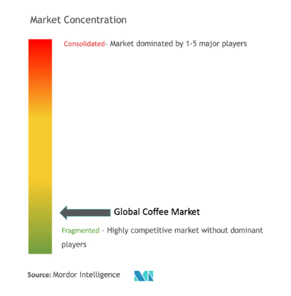
An Opportunity in the Market
Coffee consumption has risen year on year for the past decade.
Coffee chain giants have grown ascendant in the market.
Starbucks, Costa, Dunkin Donuts, Luckin.
“Highly competitive market” = new coffee distribution channels sought after.

Slide 3
The Proposal
An automated coffee vendor unattached to any brick and mortar premises with minimal staffing
Traditional Retail Coffee
Automated Vendor
High costs – staff wages and large number of store leases.
Local dominance – key markets typically held by a National Champion (Starbucks, Tim Hortons, Doutor).
Confined ability to diversify – limited avenues to innovate within the coffee chain model.
Low staffing costs – only maintenance needed.
Pop-up store license – greater flexibility in site selection and movement for pilot project.
Existing technology – multiple recent advancements in machine based coffee to produce high quality coffee without the associated skill level.

Slide 4
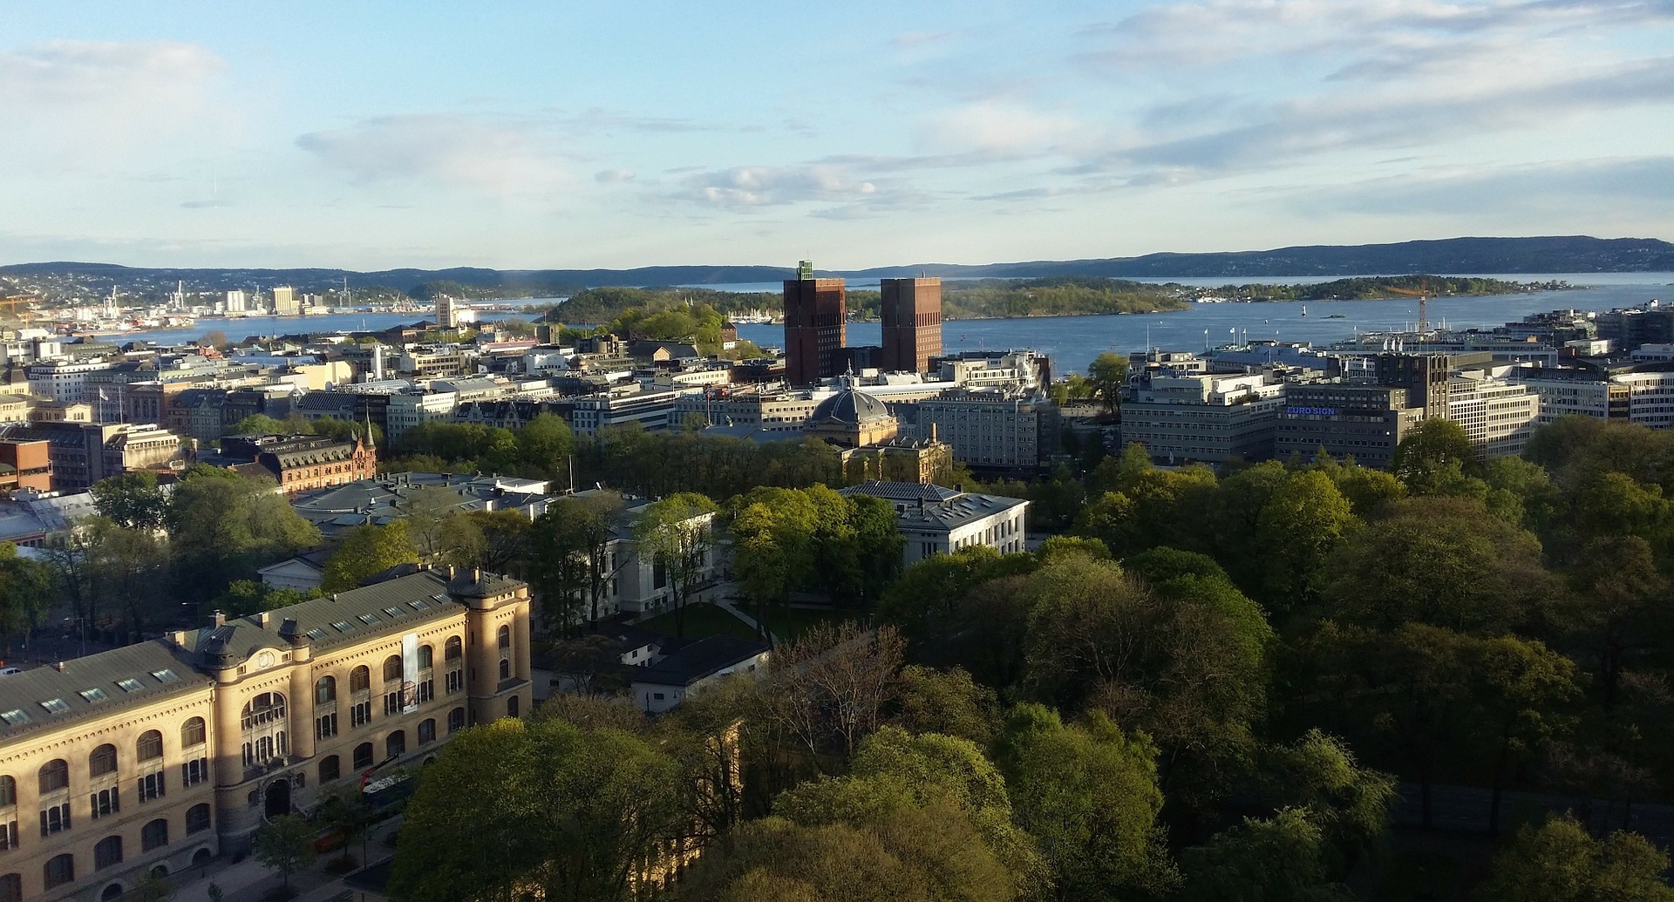
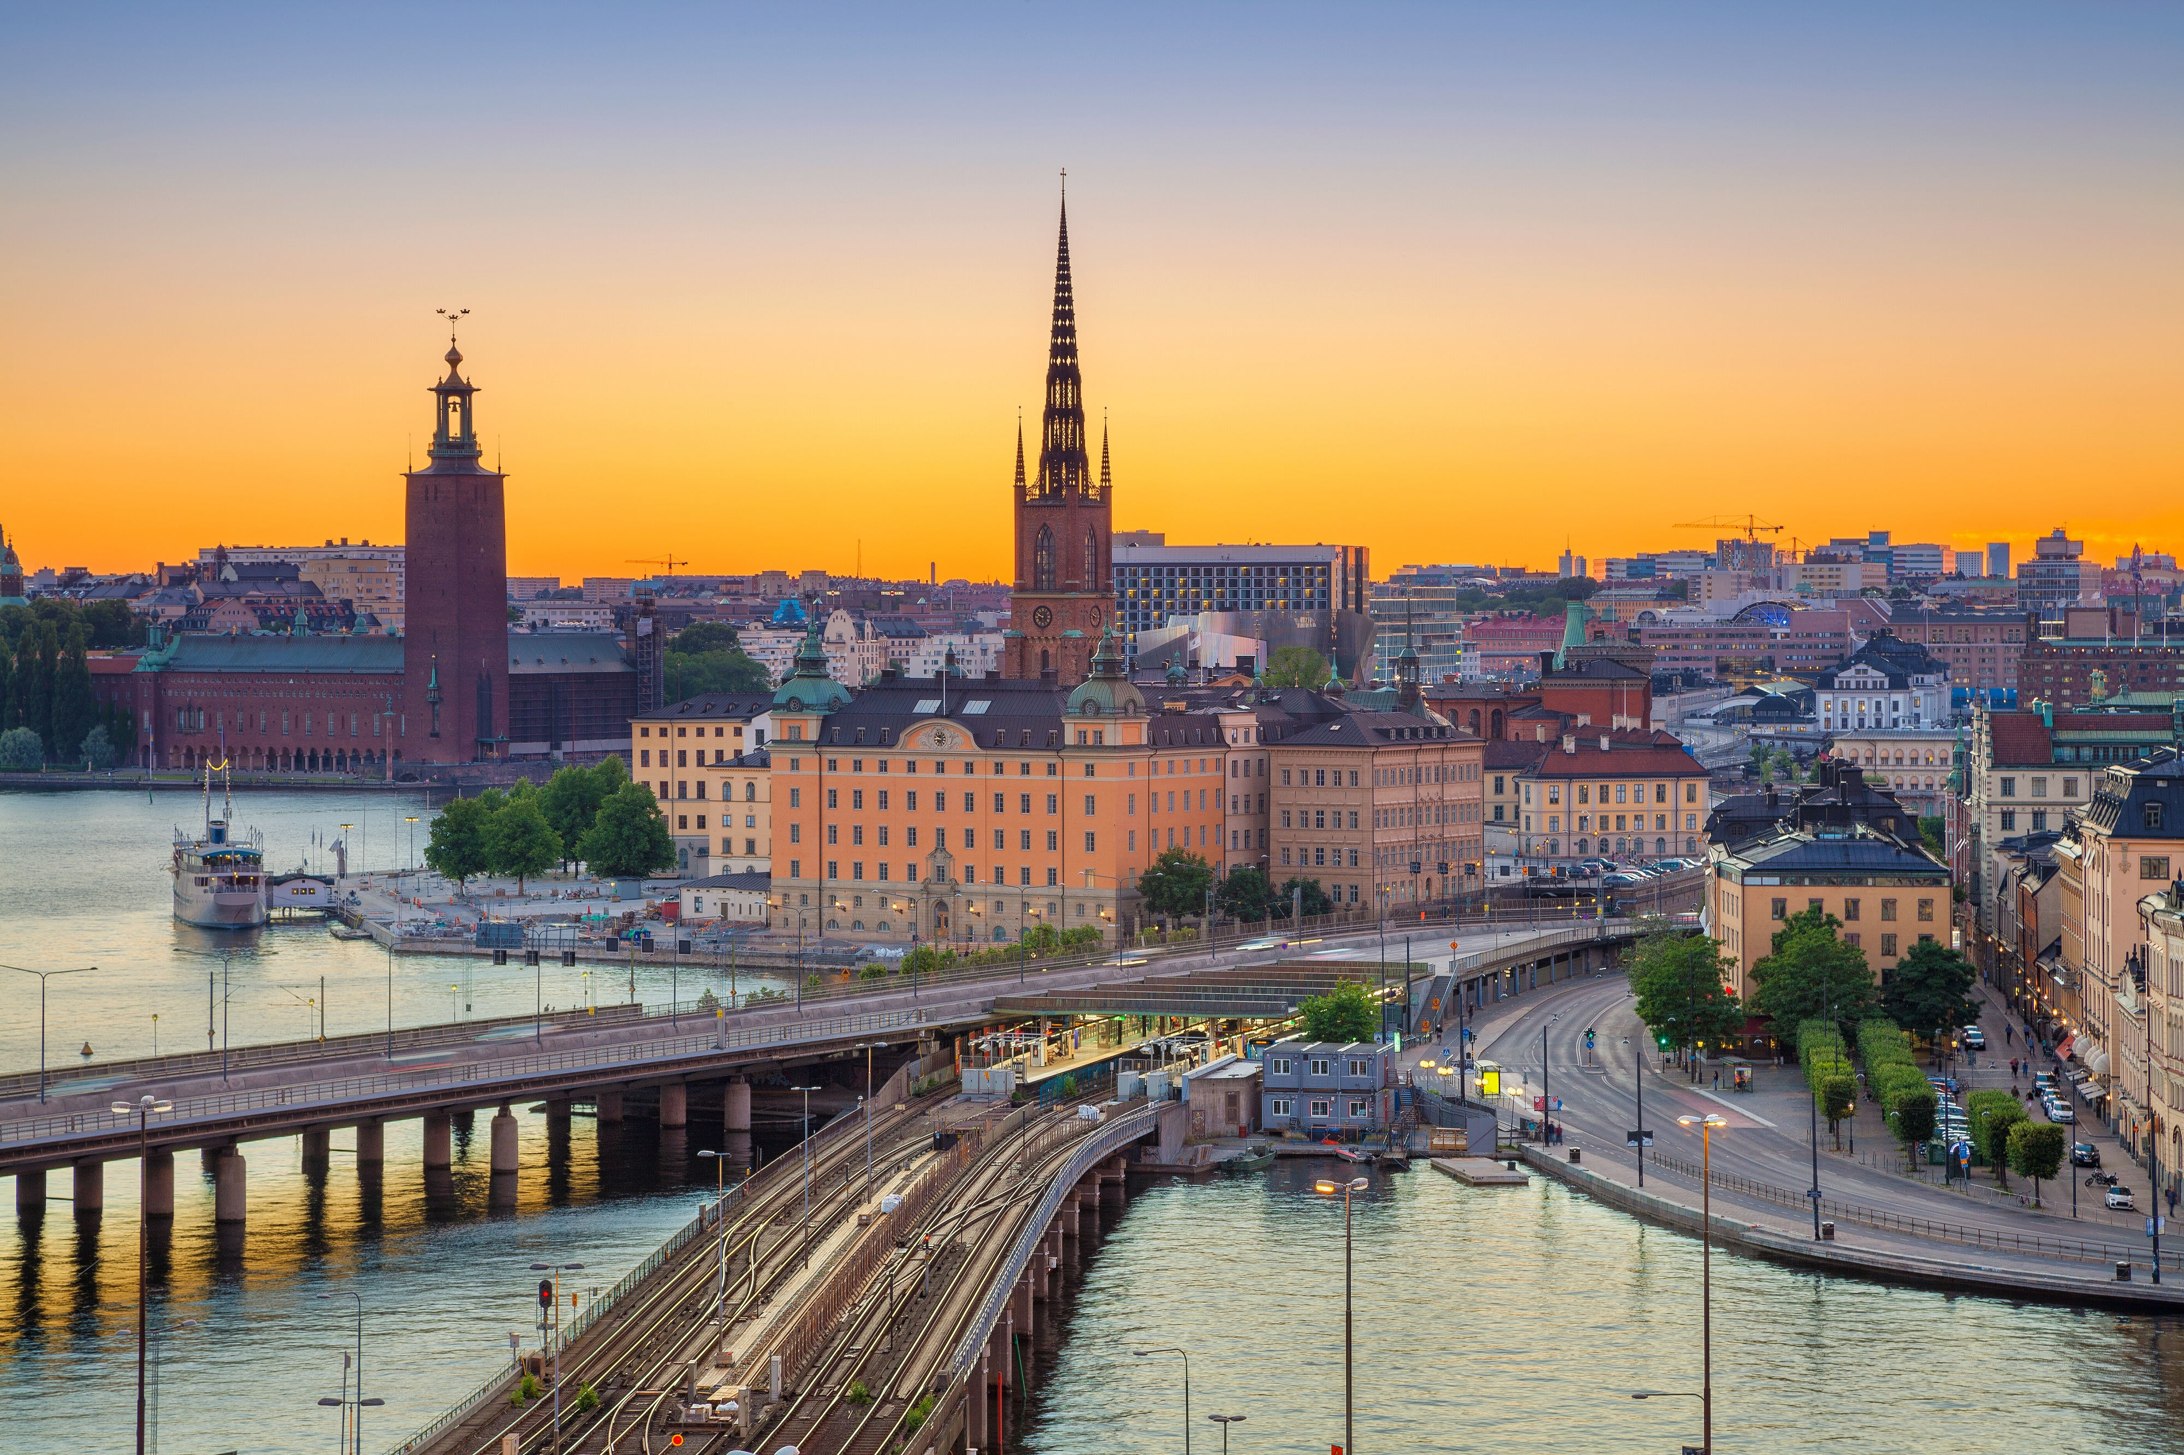
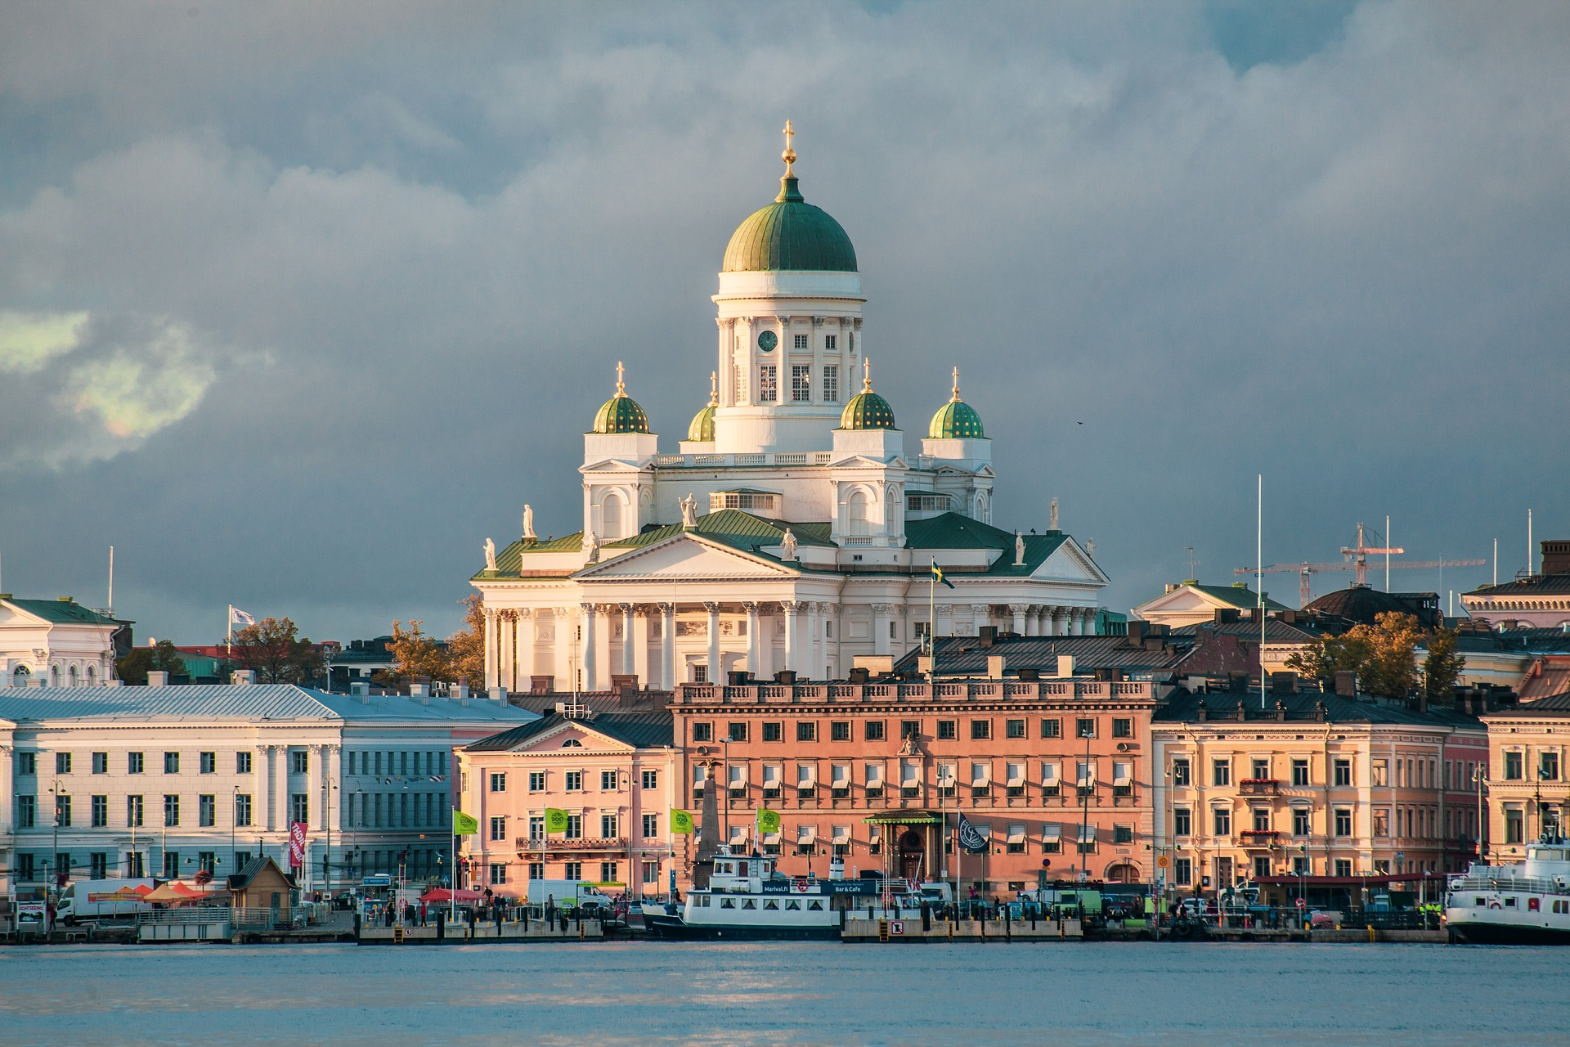
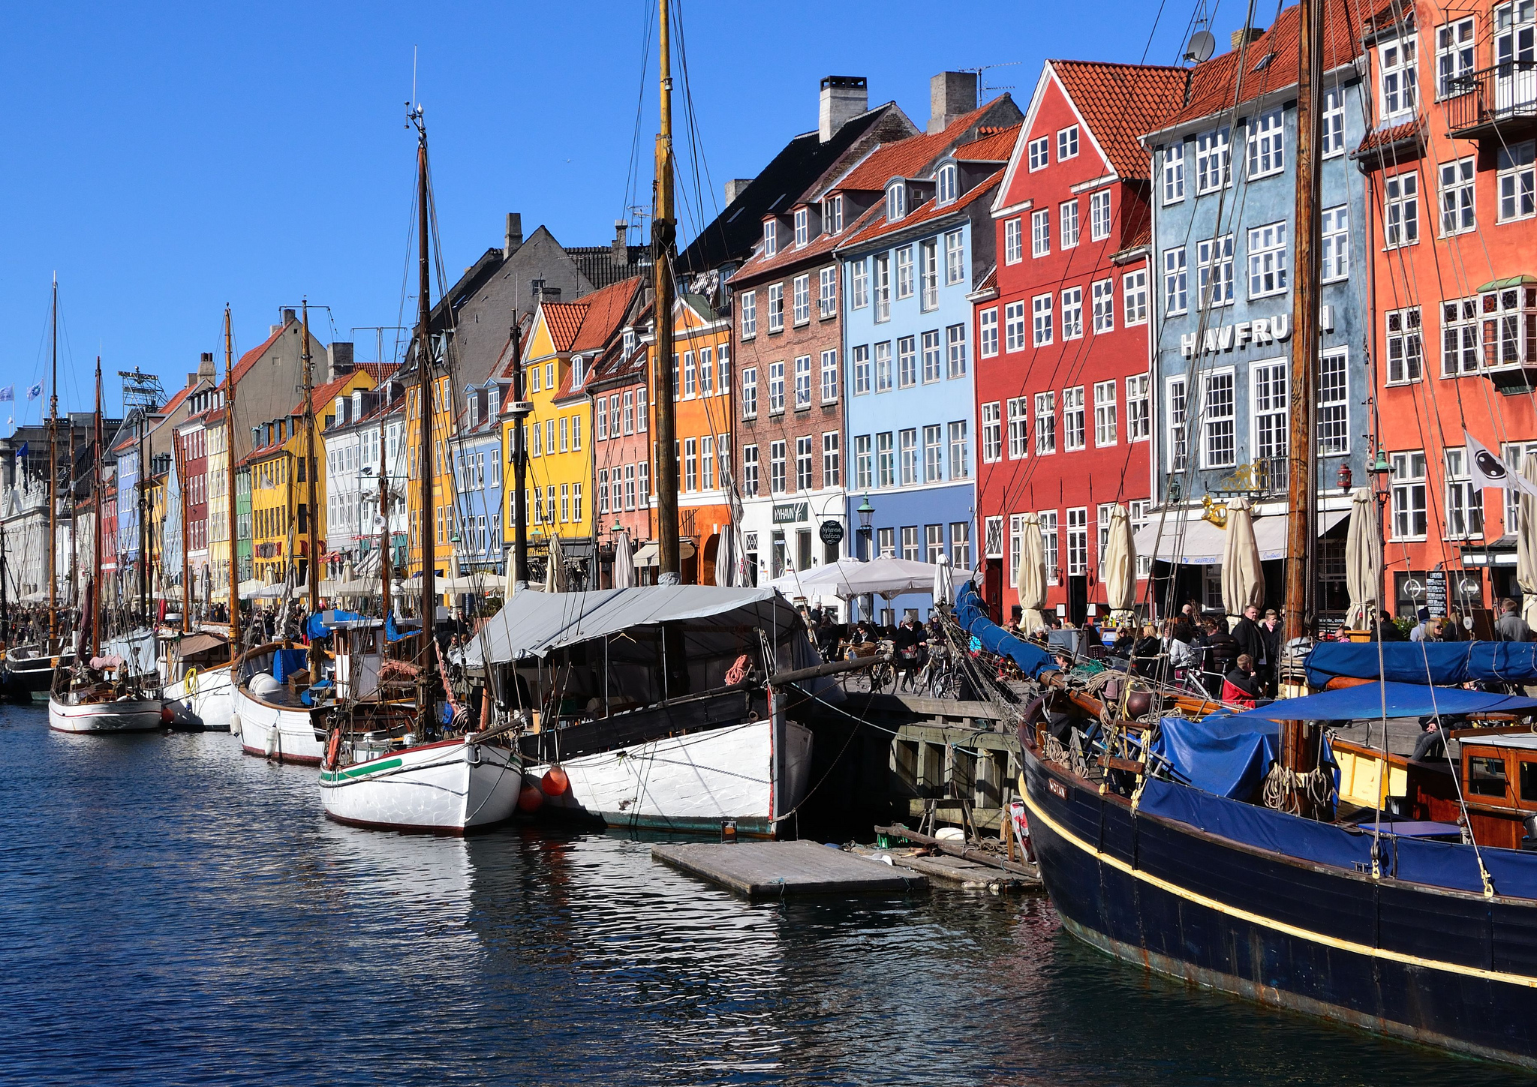
The Target Persona
Initial analysis focused on capital cities of 4 Scandinavian countries (Norway, Sweden, Finland, Denmark) - biggest coffee drinkers in the world (Coffee Nations).
Target audience = University Student.
High consumption of coffee, price sensitive.
Oslo
Stockholm
Helsinki
Copenhagen

Slide 5
Data – Acquisition and Cleaning
Data on local universities within the city districts was gathered from Unipage.
Location data (Latitude and Longitude) for each of the universities was gathered via an API from https://positionstack.com.
Venue data (venue category and location data) was gathered via https://foursquare.com.
Universities that could not be matched to a location were dropped.
The final result was 244 rows with 9 features.

Slide 6
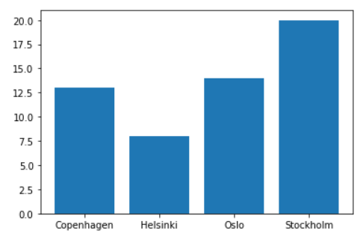
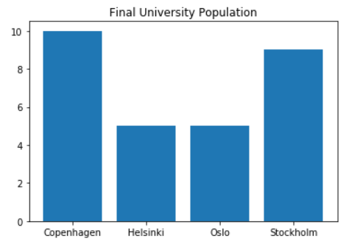
Analysis - Methodology
Significant dropoff for universities with matching locations (24 of 55 with no match).
Could be a linguistics issue or an underlying gap in PositionStack data.
University Population pre-Location API
University Population post-Location API

Slide 7
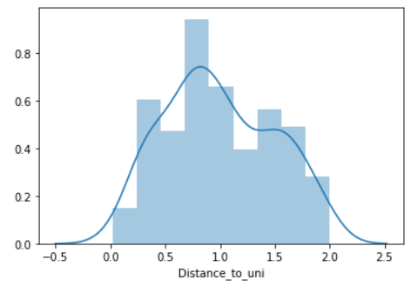
Analysis - Methodology
Venue Findings
Density Distribution of Venues Distances to University
A limit of 10 venues and a 2km radius was set for the Venue search.
Venues were restricted to “Cafés” and “Coffee Shops” only.
Each university location had an average of about 8 venues with most typically falling between .5 and 1.5 km.

Slide 8
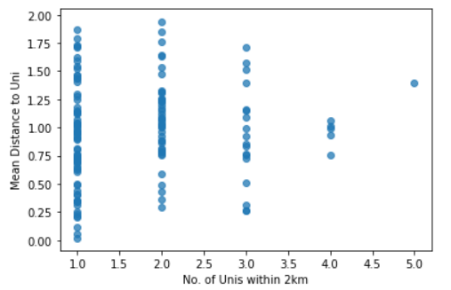
High Density Venues
Cross Referencing Universities
Mean Distance vs Number of Proximate Universities
Multiple universities were found in close proximity to one another resulting in duplicate venues.
These venues could then be counted to indicate the number of universities a particular venue was within “walking distance”(2km).
Most venues were only in range of one university with only a handful falling in range of 4 or more.

Slide 9
Clustering Results
Cluster Label | Number of Venues | Mean Distance | <2km Unis | Lowest Distance | Highest Distance
0 | 39 | .35km | 1.87 | .348km | .366km
1 | 65 | .90km | 1.4 | .886km | .922km
2 | 92 | 1.02km | 2.87 | .606km | 1.421km
3 | 48 | 1.59km | 1.92 | 1.575km | 1.606km
Cluster 0 identified as extremely proximate venues (Low Mean Distance).
Cluster 1 identified as middle banding venues for less dense universities (Low <2km Unis).
Cluster 2 identified as high university density venues (Large <2km Unis).
Cluster 3 identified as outer orbit banding (high Mean Distance, low inter-distance range).

Slide 10
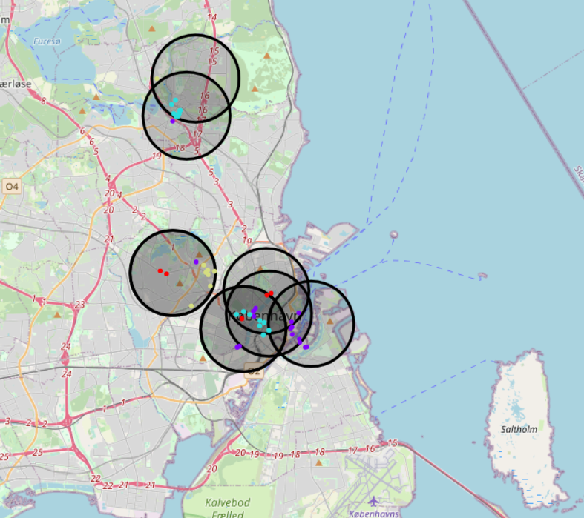
Mapping Results - Denmark
Copenhagen
Copenhagen held a fairly disparate layout with a close central cluster of universities in the south and a small pocket further North away from the centre of the city.
There were a large number of Cluster 1 and Cluster 2 venues visible by the purple and turquoise dots respectively.
Cluster 0
Cluster 1
Cluster 2
Cluster 3

Slide 11
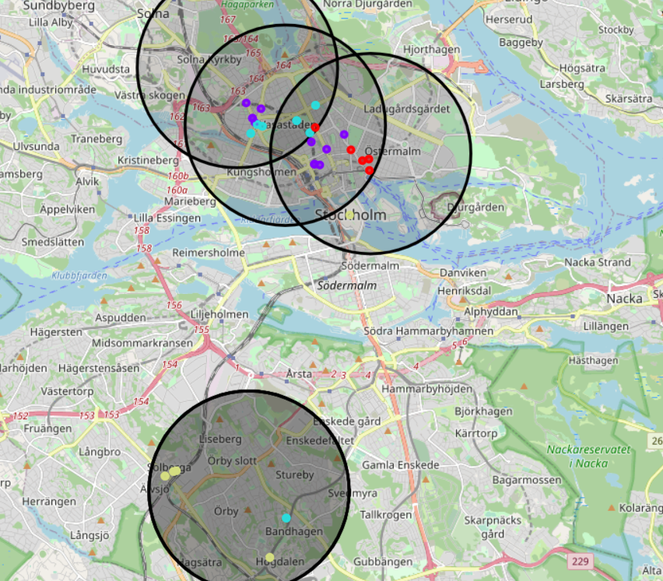
Mapping Results - Sweden
Stockholm
Stockholm possessed very few university locations in its central area with a cluster in the North and a small area in the south.
The area in the South was found to be 3 universities all located on the same campus and thus given the same coordinates.
Low number of venues, densely populated in the North.
Cluster 0
Cluster 1
Cluster 2
Cluster 3

Slide 12
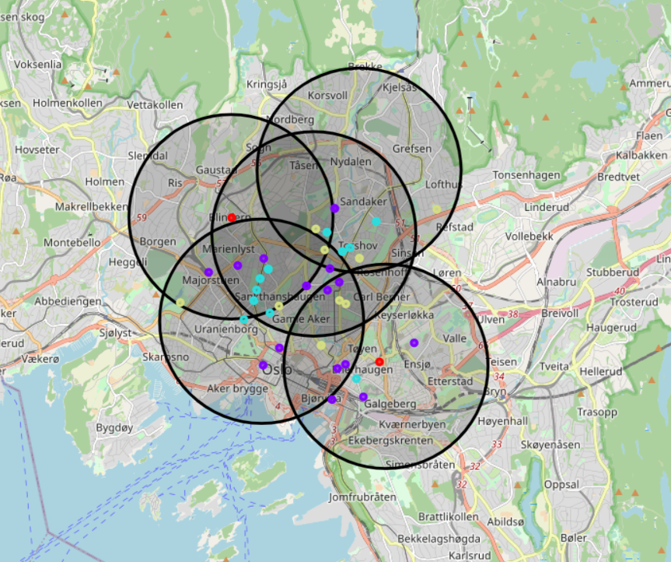
Mapping Results - Norway
Oslo
Oslo was highly centralized with all universities falling within 5km of each other.
Very few Cluster 0 venues with most venues found within a central strand of the city between all the universities – likely a shopping or high street district.
Large areas of open space in North and Northwest.
Cluster 0
Cluster 1
Cluster 2
Cluster 3

Slide 13
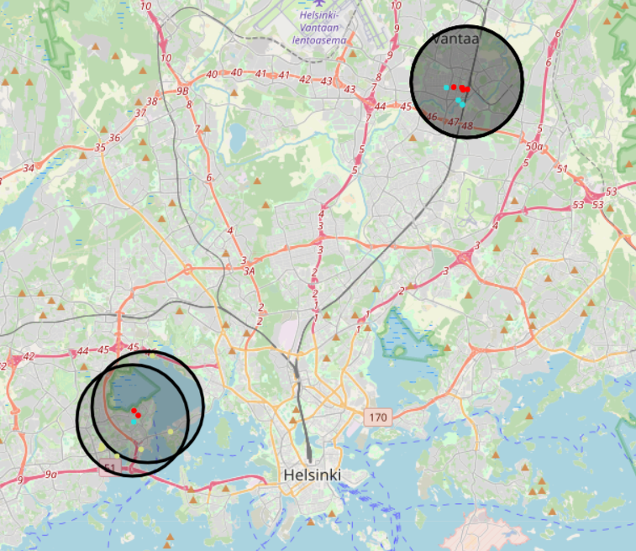
Mapping Results - Finland
Helsinki
Helsinki was extremely disparate – losing a number of universities to the PositionStack location check.
Two notable hubs – both away from the city centre and both dominated by a grouping of Cluster 0 venues.
Southeastern hub likely on the one campus is also coastal resulting in more limited land availability around those universities.
Cluster 0
Cluster 1
Cluster 2
Cluster 3

Slide 14
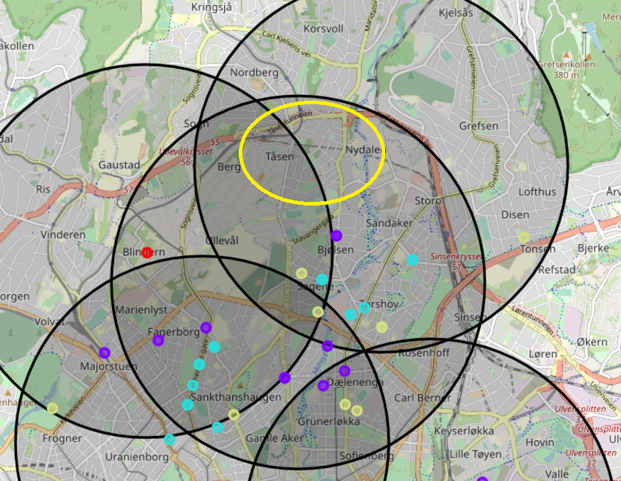
Recommendation
Oslo provides the best combination of factors:
Low number of Cluster 0 venues (close proximity).
Large number of Cluster 3 venues (highly distant).
Large areas of open space within range of multiple competitors with few direct competitors.
A candidate location of high potential has been indicated within the yellow circle.

Slide 15
Concluding Remarks
Insightful but brief glimpse into the potential of the 4 city locations for hosting the coffee vendor pilot project.
Possible areas of improvement:
Incomplete location data – more reliable geolocator or translation exercise needed to capture more universities.
Parameters set on venues could be expanded by including certain restaurants or convenience stores within the venue category.
Other focal points besides universities could also be used to expand the range of the analysis and better inform the model.

